Slide 1
Types of Software Requirements
33
Functional requirements
Non-functional requirements
Domain requirements
Inverse requirements
Design and implementation constraints

Slide 2
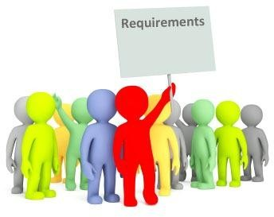
Functional Requirements
35
Functional Requirements can be stated from either static or dynamic perspective
The dynamic perspective describes the behavior of the system in terms of results
The static perspective describes the functions performed by each entity and the way each interacts with other entities and the environment
Abnormal behavior is also documented as functional requirements in the form of
exception handling
Functional requirements should be complete and consistent
Customers and developers usually focus all their attention on functional requirements

Slide 3
Functional Requirements
Backbone of
Requirements
34
In software engineering, a functional requirement defines a function of a software
system or its component.
A function is described as a set of inputs, the behavior, and outputs.
Functional requirements may be calculations, technical details, data manipulation and processing and other specific functionality that define what a system is supposed to accomplish.
Functional requirements are the statements and services that system should provide in two clearly described external behaviors
Reaction to particular input (e.g give some input to software and it produces a result)
Behavior in particular situations (e.g If I click on an exit button then system behaves in a particular way)

Slide 4
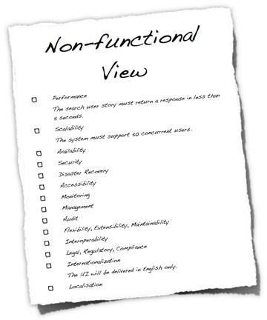
Non-Functional Requirements
36
In requirements engineering, a non- functional requirement is a requirement that specifies criteria that can be used to judge the operation of a system, rather than specific behaviors.
Non-functional requirements are often called qualities of a system. Other terms for non-functional requirements are "constraints", "quality attributes", "quality goals", "quality of service requirements" and "non-behavioral requirements".
Informally these are sometimes called the "ilities", from attributes like stability and portability.

Slide 5
Non-Functional Requirements
37
Types | Explanation
Product requirements: | specify that the delivered product must behave in a particular way e.g. execution speed, reliability, etc.
Organizational requirements: | are a consequence of organizational policies and procedures e.g. process standards used, implementation requirements, etc.
External requirements: | arise from factors which are external to the system and its development process e.g. interoperability requirements, legislative requirements, etc.

Slide 6





















Non-Functional Requirements
38
Non-functional requirements
Product
Organizational requirements
Exte requir
rnal ements
requirements
Efficiency
Reliability
Portability
Interoperability
Ethical
requir ements
requirements
requirements
requirements
requirements
Usability requirements
Delivery
Implementation requirements
Standards
Legislative
requirements
requirements
requirements
Performance
Space
Privacy
Safety
requirements
requirements
requirements
requirements

Slide 7
Domain Requirements
39
Requirements that come from the application domain and reflect fundamental characteristics of that application domain
These can be both the functional or non-functional requirements
These requirements, sometimes, are not explicitly mentioned
Their absence can cause significant dissatisfaction
Domain requirements can impose strict constraints on solutions
Domain-specific terminology can also cause confusion
Example:
In a commission-based sales businesses, there is no concept of negative commission.
However, if
care is not taken novice developers can be tempted into developing systems, which calculate negative commission

Slide 8
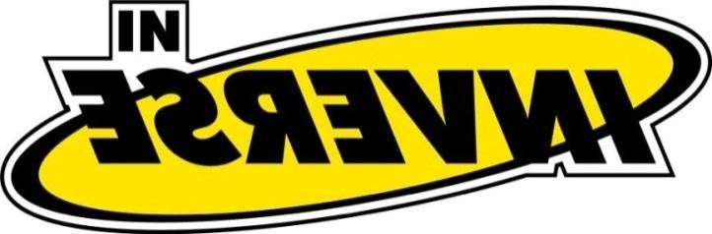




Inverse Requirements
40
They explain what the system shall not do.
Inverse requirements describe the constraints on the allowable behaviors
Many people find it convenient to describe their needs in this
manner
These requirements indicate the indecisive nature of customers about certain aspects of a new software product
Example:
The system shall not use red color in the user interface, whenever it is asking for inputs from the end-user
Safety and security requirements are usually stated in this
manner

Slide 9
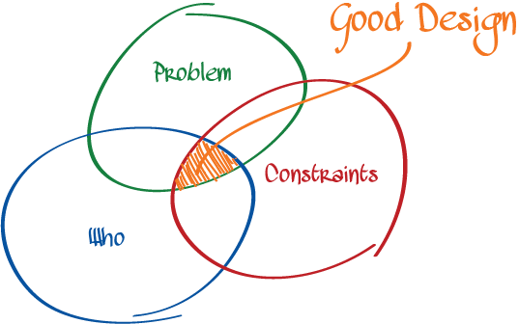


Design and Implementation Constraints
41
They are development guidelines within which the designer must work
These requirements can seriously limit design and implementation options
Can also have impact on human resources
Example:
The system shall be developed using the Microsoft .Net platform
The system shall be developed using open source tools[4] and shall run on
Linux operating system
The System should be implemented using c sharp language
The software must fit into the memory of a 512Kbyte machine.

Slide 10





Problem Domain
Problem Domain
42
Most successful requirements journeys begin with a trip to the land of problem.
This problem domain is the home of real users and other stakeholders, people whose needs must be addressed in order for us to build the perfect system.
This is the home of the people who need the rock or a new sales order entry system or a configuration management system good enough to blow the competition away.
In all probability, these people are not like us. Their technical and economic backgrounds are different from ours.
On rare occasions, they are just like us. They are programmers looking for a new tool or system developers who have asked you to develop a portion of the system.

Slide 11


Problem Domain
43
These users have business or technical problems that they need our help to solve.
Therefore, it becomes our problem to understand their problems, in their culture and their language, and to build systems that meet their needs.
Within the problem domain, we use a set of team skills to gain an understanding of the problem and the needs that must be filled to address this problem.

Slide 12
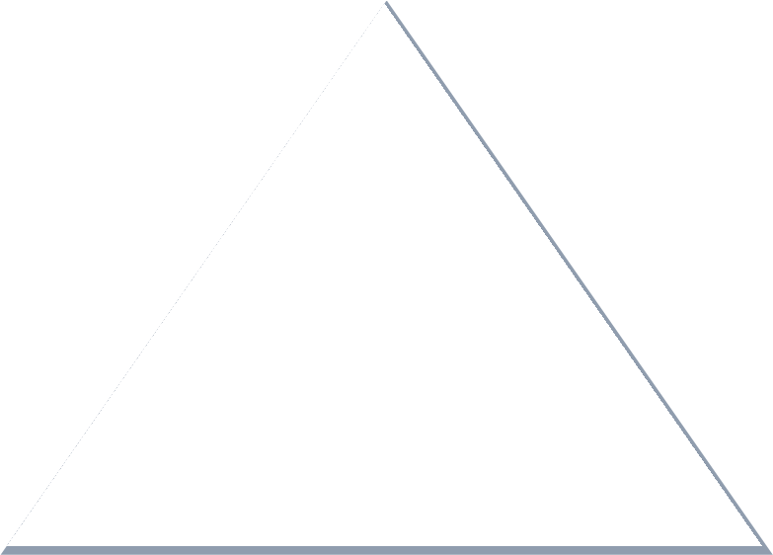

Stakeholder Needs
44
Stakeholders are people who have a stake or interest in the project
It is also our responsibility to understand the needs of users and other stakeholders whose lives will be affected by our solution.
As we elicit those needs, we'll stack them in a little pile called stakeholder needs, which we represent as a pyramid.
Needs

Slide 13
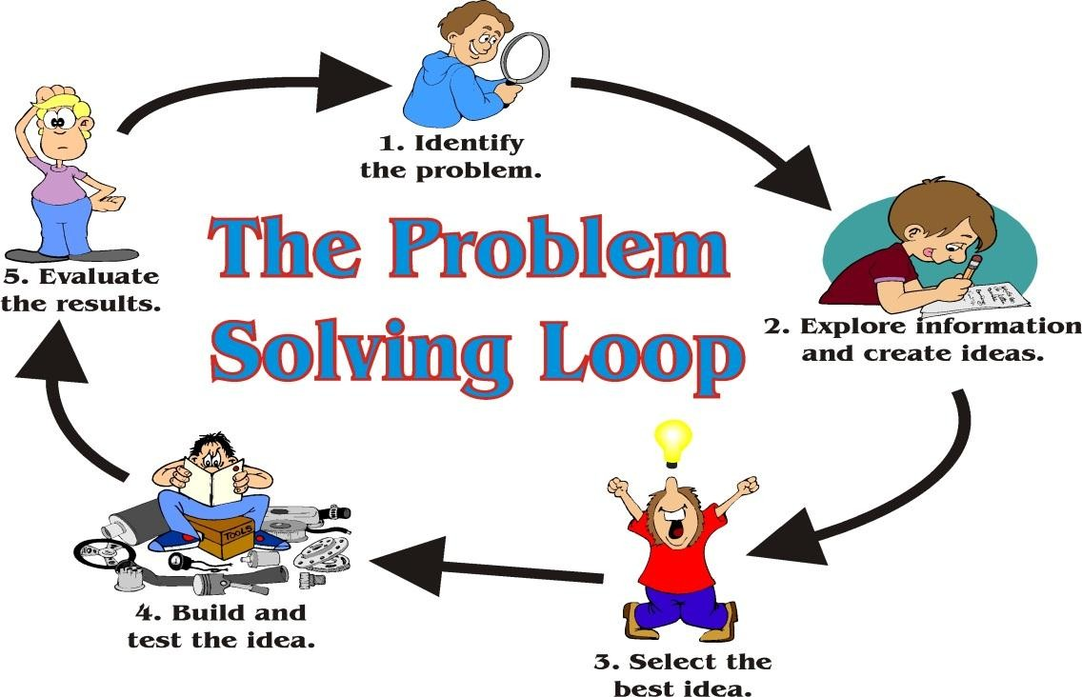
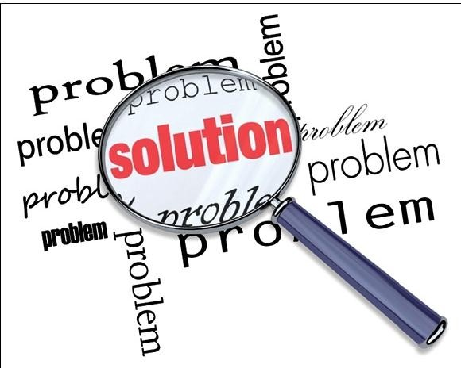
Moving towards the solution domain
45
We move to Solution domain from the problem domain in order to provide a solution to the problem at hand.
In the solution space, we focus on defining a solution to the user's problem; this is the realm of computers, programming, operating systems, networks, and processing nodes. Here, we can apply the skills we have learned much more directly.

Slide 14
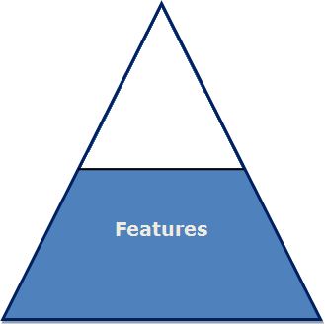

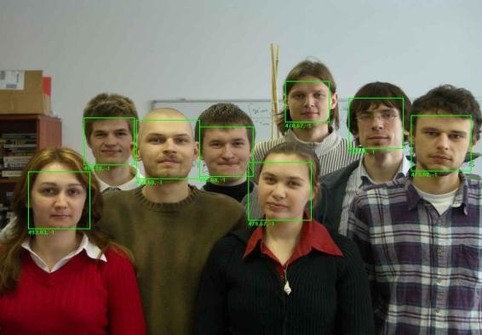
Moving towards the solution domain
46
Features of the System
a service provided by the system that fulfills one or more stakeholder needs.
This list could consists of such items as the following.
"The car will have power windows.―
"The cell provides pattern to lock screen"
― The Attendance of students will be enrolled through face recognition ."
These are simple descriptions, in the user's language, that we will use as labels to communicate with the user how our system addresses the problem.

Slide 15
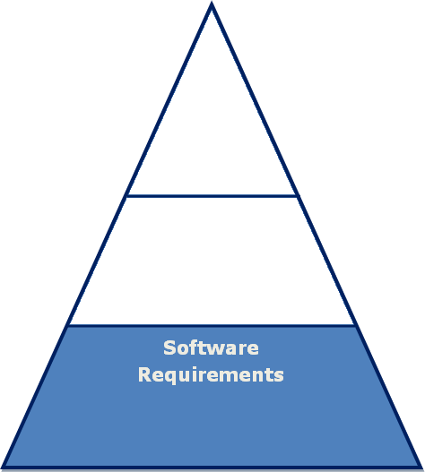
Moving towards the solution domain
47
Software Requirements
Once we have established the feature set and have gained agreement with the customer, we can move on to defining the more specific requirements we will need to impose on the solution.
If we build a system that conforms to those requirements, we can be certain that the system we develop will deliver the features we promised. In turn, since the features address one or more stakeholder needs, we will have addressed those needs directly in the solution.
These more specific requirements are the software requirements.

Slide 16
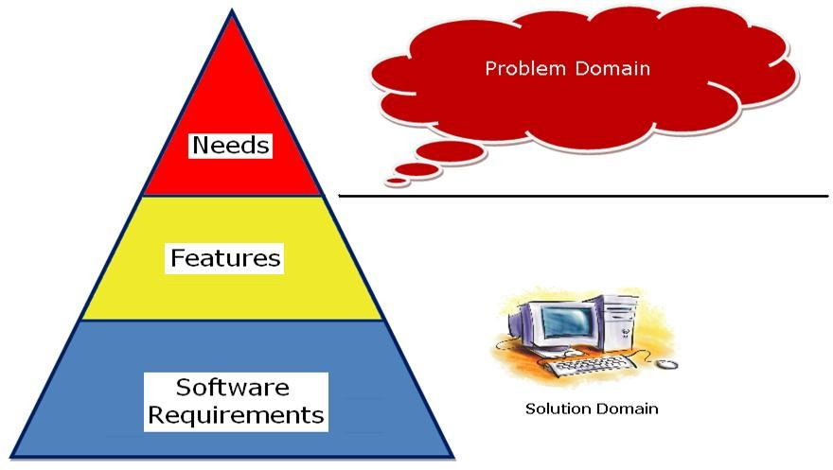
Overview of the Problem Domain and Solution Domain
48
We have moved from the problem domain, represented by the user needs we discovered, to a definition of a system that will constitute the solution domain, represented by the features of the system and the software requirements that will drive its design and implementation.

Slide 17
References
49
Managing Software Requirements: A Use Case Approach, Second Edition By Dean Leffingwell, Don Widrig, Addison- Wesley
http://en.wikipedia.org/wiki/Functional_requirement http://en.wikipedia.org/wiki/Non-functional_requirement
http://www.webopedia.com/TERM/O/open_source_tools.html http://www.sei.cmu.edu/reports/90cm019.pdf http://finntrack.co.uk/learners/business_society.htm http://en.wikipedia.org/wiki/Requirement
http://www.cs.st-andrews.ac.uk/~ifs/Books/SE9/Web/Requirements/DomainReq.html
http://faculty.salisbury.edu/~xswang/Research/Papers/SERelated/no-silver- bullet.pdf
10. http://en.wikipedia.org/wiki/Requirements_management
1.
2.
3.
4.
5.
6.
7.
8.
9.

